Slide 1
Data Mining Chapter 3
Classification

Slide 2
Supervised vs. Unsupervised Learning
Supervised learning (classification)
Supervision: The training data (observations, measurements, etc.) are accompanied by labels indicating the class of the observations
New data is classified based on the training set
Unsupervised learning (clustering)
The class labels of training data is unknown
Given a set of measurements, observations, etc. with the aim of establishing the existence of classes or clusters in the data

Slide 3
Prediction Problems: Classification vs. Numeric Prediction
Classification
predicts categorical class labels (discrete or nominal)
classifies data (constructs a model) based on the training set and the values (class labels) in a classifying attribute and uses it in classifying new data
Numeric Prediction
models continuous-valued functions, i.e., predicts unknown or missing values
Typical applications
Credit/loan approval:
Medical diagnosis: if a tumor is cancerous or benign
Fraud detection: if a transaction is fraudulent
Web page categorization: which category it is

Slide 4
Classification
Classification is a data mining technique used to predict group membership of data instances.
Classification assigns items on a collection to target categories or classes.
The goal of classification is to accurately predict the target class for each case in the data.
Unclassified Data Set
Classified Data Set
Classifier

Slide 5
Classification—A Two-Step Process
Model construction: describing a set of predetermined classes
Each tuple /sample is assumed to belong to a predefined class, as determined by the class label attribute
The set of tuples used for model construction is training set
The model is represented as classification rules, decision trees, or mathematical formulae
Model usage: for classifying future or unknown objects
Estimate accuracy of the model
The known label of test sample is compared with the classified result from the model
Accuracy rate is the percentage of test set samples that are correctly classified by the model
Test set is independent of training set (otherwise overfitting)
If the accuracy is acceptable, use the model to classify new data
Note: If the test set is used to select models, it is called validation (test) set

Slide 6
Stages in classification
Training data
Conceptual Model
Model Learning
Model
Evaluation
Apply Model
Test Data
Training Algorithm

Slide 7
Process (1): Model Construction
Classification
Algorithms
Training
Data
Classifier
(Model)
IF rank = ‘professor’
OR years > 6
THEN tenured = ‘yes’

Slide 8
Process (2): Using the Model in Prediction
Classifier
Testing
Data
Unseen Data
(Jeff, Professor, 4)
Tenured?

Slide 9

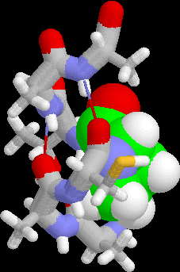
Examples of classification tasks
Two classes
Predicting tumor cells as benign or malignant
Classifying credit card transactions as legitimate or fraudulent
Multiple classes
Classifying secondary structures of protein as alpha-helix, beta-sheet, or random coil
Categorizing news stories as finance, weather, entertainment, sports, etc
Notes:
Examples 3 & 4 are multiclass classification problems.

Slide 10
Classification Types
Decision Tree classifier
Rule Based Classifier
Nearest Neighbor Classifier
Bayesian Classifier
Artificial Neural Network (ANN) Classifier
Others

Slide 11
Decision Tree classifier
A decision tree is tree in which each branch node represents a choice between a number of alternatives and each leaf node represents a classification or decision.
Decision tree is a classifier in the form of a tree structure where a leaf node indicates the class of instances, a decision node specifies some test to be carried out on a single attribute value with one branch and sub-tree for each possible outcome of the test.
A decision tree can be used to classify an instance by starting at root of the tree and moving through it until leaf node. The leaf node provides the corresponding class of instance.

Slide 12
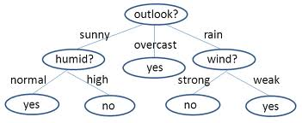
Decision Tree classifier

Slide 13
Decision Tree Algorithm
Hunt’s Algorithm
ID3, J48, C4.5 (Based on Entropy Calculation)
SLIQ,SPRINT,CART (Based on Gini-Index)

Slide 14
Hunt’s Algorithm
Hunt's algorithm grows a decision tree in a recursive fashion by partitioning the training data into successively into subsets.
Let Dt be the set of training data that reach a node ‘t’. The general recursive procedure is defined as:
If Dt contains records that belong the same class y_{t}, then t is a leaf node labeled as y_{t.}
If Dt is an empty set, then t is a leaf node labeled by the default class, y_{d}
If Dt contains records that belong to more than one class, use an attribute test to split the data into smaller subsets.

Slide 15
Hunt’s Algorithm
It recursively applies the procedure to each subset until all the records in the subset belong to the same class.
The Hunt's algorithm assumes that each combination of attribute sets has a unique class label during the procedure.
If all the records associated with Dt have identical attribute values except for the class label, then it is not possible to split these records any future. In this case, the node is declared a leaf node with the same class label as the majority class of training records associated with this node.

Slide 16
Decision Tree Induction: An Example
Training data set: Buys_computer
The data set follows an example of Quinlan’s ID3 (Playing Tennis)
Resulting tree:
age?
<=30
31..40
>40
student?
yes
credit rating?
no
yes
excellent
fair
no
yes
no
yes

Slide 17
Example of a decision tree
nominal
nominal
ratio
class
splitting nodes
Refund
Yes
No
NO
MarSt
Single, Divorced
Married
TaxInc
NO
< 80K
> 80K
NO
YES
classification nodes
training data
model: decision tree
Notes:
Rows = samples / instances
Columns = attributes / variables
Internal nodes (yellow) = splitting nodes
Leaf nodes (blue) = classification nodes

Slide 18
Another example of decision tree
nominal
nominal
ratio
class
MarSt
Single, Divorced
Married
NO
Refund
Yes
No
NO
TaxInc
< 80K
> 80K
NO
YES
There can be more than one tree that fits the same data!
Notes:
Potentially exponentially many trees. Finding optimal tree is NP-hard.

Slide 19
Decision tree classification task
Decision Tree
Notes:
First let’s see how to use a decision tree that’s already been built (aka trained, induced).

Slide 20
Algorithm for Decision Tree Induction
Basic algorithm (a greedy algorithm)
Tree is constructed in a top-down recursive divide-and-conquer manner
At start, all the training examples are at the root
Attributes are categorical (if continuous-valued, they are discretized in advance)
Examples are partitioned recursively based on selected attributes
Test attributes are selected on the basis of a heuristic or statistical measure (e.g., information gain)
Conditions for stopping partitioning
All samples for a given node belong to the same class
There are no remaining attributes for further partitioning – majority voting is employed for classifying the leaf
There are no samples left

Slide 21
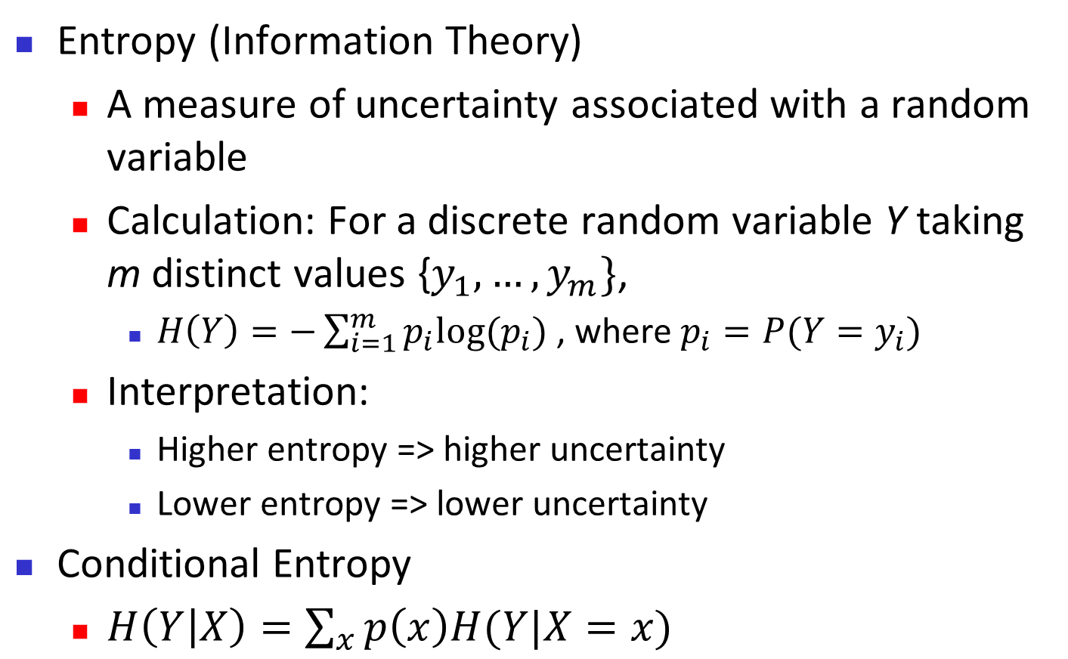
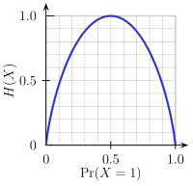
Brief Review of Entropy
m = 2

Slide 22
Attribute Selection Measure: Information Gain (ID3/C4.5)
Select the attribute with the highest information gain
Let p_{i} be the probability that an arbitrary tuple in D belongs to class C_{i}, estimated by |C_{i, D}|/|D|
Expected information (entropy) needed to classify a tuple in D:
Information needed (after using A to split D into v partitions) to classify D:
Information gained by branching on attribute A
Notes:
I : the expected information needed to classify a given sample
E (entropy) : expected information based on the partitioning into subsets by A

Slide 23
Attribute Selection: Information Gain
Class P: buys_computer = “yes”
Class N: buys_computer = “no”
means “age <=30” has 5 out of 14 samples, with 2 yes’es and 3 no’s. Hence
Similarly,

Slide 24
Class Work
Day | Outlook | Temperature | Humidity | Wind | Play cricket
1 | Sunny | Hot | High | Weak | No
2 | Sunny | Hot | High | Strong | No
3 | Overcast | Hot | High | Weak | Yes
4 | Rain | Mild | High | Weak | Yes
5 | Rain | Cool | Normal | Weak | Yes
6 | Rain | Cool | Normal | Strong | No
7 | Overcast | Cool | Normal | Strong | Yes
8 | Sunny | Mild | High | Weak | No
9 | Sunny | Cool | Normal | Weak | Yes
10 | Rain | Mild | Normal | Weak | Yes
11 | Sunny | Mild | Normal | Strong | Yes
12 | Overcast | Mild | High | Strong | Yes
13 | Overcast | Hot | Normal | Weak | Yes
14 | Rain | Mild | High | Strong | No

Slide 25
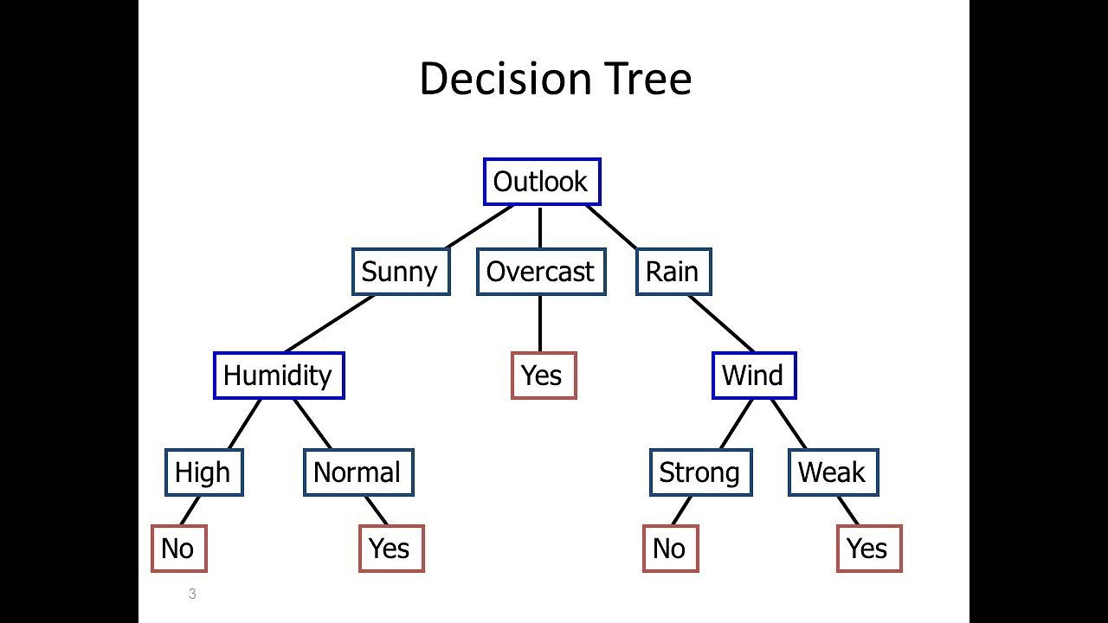
Final Result

Slide 26
Computing Information-Gain for Continuous-Valued Attributes
Let attribute A be a continuous-valued attribute
Must determine the best split point for A
Sort the value A in increasing order
Typically, the midpoint between each pair of adjacent values is considered as a possible split point
(a_{i}+a_{i+1})/2 is the midpoint between the values of a_{i} and a_{i+1}
The point with the minimum expected information requirement for A is selected as the split-point for A
Split:
D1 is the set of tuples in D satisfying A ≤ split-point, and D2 is the set of tuples in D satisfying A > split-point

Slide 27
Gain Ratio for Attribute Selection (C4.5)
Information gain measure is biased towards attributes with a large number of values
C4.5 (a successor of ID3) uses gain ratio to overcome the problem (normalization to information gain)
GainRatio(A) = Gain(A)/SplitInfo(A)
Ex.
gain_ratio(income) = 0.029/1.557 = 0.019
The attribute with the maximum gain ratio is selected as the splitting attribute

Slide 28
Gini Index (CART, IBM IntelligentMiner)
If a data set D contains examples from n classes, gini index, gini(D) is defined as
where p_{j} is the relative frequency of class j in D
If a data set D is split on A into two subsets D₁ and D₂, the gini index gini(D) is defined as
Reduction in Impurity:
The attribute provides the smallest gini_{split}(D) (or the largest reduction in impurity) is chosen to split the node (need to enumerate all the possible splitting points for each attribute)

Slide 29
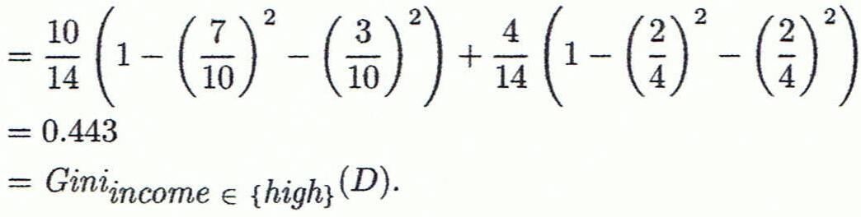
Computation of Gini Index
Ex. D has 9 tuples in buys_computer = “yes” and 5 in “no”
Suppose the attribute income partitions D into 10 in D₁: {low, medium} and 4 in D₂
Gini_{{low,high}} is 0.458; Gini_{{medium,high}} is 0.450. Thus, split on the {low,medium} (and {high}) since it has the lowest Gini index
All attributes are assumed continuous-valued
May need other tools, e.g., clustering, to get the possible split values
Can be modified for categorical attributes

Slide 30
Comparing Attribute Selection Measures
The three measures, in general, return good results but
Information gain:
biased towards multivalued attributes
Gain ratio:
tends to prefer unbalanced splits in which one partition is much smaller than the others
Gini index:
biased to multivalued attributes
has difficulty when # of classes is large
tends to favor tests that result in equal-sized partitions and purity in both partitions

Slide 31
Other Attribute Selection Measures
CHAID: a popular decision tree algorithm, measure based on χ² test for independence
C-SEP: performs better than info. gain and gini index in certain cases
G-statistic: has a close approximation to χ² distribution
MDL (Minimal Description Length) principle (i.e., the simplest solution is preferred):
The best tree as the one that requires the fewest # of bits to both (1) encode the tree, and (2) encode the exceptions to the tree
Multivariate splits (partition based on multiple variable combinations)
CART: finds multivariate splits based on a linear comb. of attrs.
Which attribute selection measure is the best?
Most give good results, none is significantly superior than others

Slide 32
Overfitting and Tree Pruning
Overfitting: An induced tree may overfit the training data
Too many branches, some may reflect anomalies due to noise or outliers
Poor accuracy for unseen samples
Two approaches to avoid overfitting
Prepruning: Halt tree construction early ̵ do not split a node if this would result in the goodness measure falling below a threshold
Difficult to choose an appropriate threshold
Postpruning: Remove branches from a “fully grown” tree—get a sequence of progressively pruned trees
Use a set of data different from the training data to decide which is the “best pruned tree”

Slide 33
Enhancements to Basic Decision Tree Induction
Allow for continuous-valued attributes
Dynamically define new discrete-valued attributes that partition the continuous attribute value into a discrete set of intervals
Handle missing attribute values
Assign the most common value of the attribute
Assign probability to each of the possible values
Attribute construction
Create new attributes based on existing ones that are sparsely represented
This reduces fragmentation, repetition, and replication

Slide 34
Classification in Large Databases
Classification—a classical problem extensively studied by statisticians and machine learning researchers
Scalability: Classifying data sets with millions of examples and hundreds of attributes with reasonable speed
Why is decision tree induction popular?
relatively faster learning speed (than other classification methods)
convertible to simple and easy to understand classification rules
can use SQL queries for accessing databases
comparable classification accuracy with other methods
RainForest (VLDB’98 — Gehrke, Ramakrishnan & Ganti)
Builds an AVC-list (attribute, value, class label)

Slide 35
Rainforest: Training Set and Its AVC Sets
Training Examples
AVC-set on Age
AVC-set on income
Age | Buy_Computer
 | yes | no
<=30 | 2 | 3
31..40 | 4 | 0
>40 | 3 | 2
income | Buy_Computer
 | yes | no
high | 2 | 2
medium | 4 | 2
low | 3 | 1
AVC-set on Student
AVC-set on
credit_rating
student | Buy_Computer
 | yes | no
yes | 6 | 1
no | 3 | 4
Credit Rating | Buy_Computer
 | yes | no
Fair | 6 | 2
Excellent | 3 | 3

Slide 36
Bayesian Classification: Why?
A statistical classifier: performs probabilistic prediction, i.e., predicts class membership probabilities
Foundation: Based on Bayes’ Theorem.
Performance: A simple Bayesian classifier, naïve Bayesian classifier, has comparable performance with decision tree and selected neural network classifiers
Incremental: Each training example can incrementally increase/decrease the probability that a hypothesis is correct — prior knowledge can be combined with observed data
Standard: Even when Bayesian methods are computationally intractable, they can provide a standard of optimal decision making against which other methods can be measured

Slide 37
Bayes’ Theorem: Basics
Total probability Theorem:
Bayes’ Theorem:
Let X be a data sample (“evidence”): class label is unknown
Let H be a hypothesis that X belongs to class C
Classification is to determine P(H|X), (i.e., posteriori probability): the probability that the hypothesis holds given the observed data sample X
P(H) (prior probability): the initial probability
E.g., X will buy computer, regardless of age, income, …
P(X): probability that sample data is observed
P(X|H) (likelihood): the probability of observing the sample X, given that the hypothesis holds
E.g., Given that X will buy computer, the prob. that X is 31..40, medium income

Slide 38
Prediction Based on Bayes’ Theorem
Given training data X, posteriori probability of a hypothesis H, P(H|X), follows the Bayes’ theorem
Informally, this can be viewed as
posteriori = likelihood x prior/evidence
Predicts X belongs to C_{i} iff the probability P(C_{i}|X) is the highest among all the P(C_{k}|X) for all the k classes
Practical difficulty: It requires initial knowledge of many probabilities, involving significant computational cost

Slide 39
Classification Is to Derive the Maximum Posteriori
Let D be a training set of tuples and their associated class labels, and each tuple is represented by an n-D attribute vector X = (x₁, x₂, …, x_{n})
Suppose there are m classes C₁, C₂, …, C_{m}.
Classification is to derive the maximum posteriori, i.e., the maximal P(C_{i}|X)
This can be derived from Bayes’ theorem
Since P(X) is constant for all classes, only
needs to be maximized

Slide 40
Naïve Bayes Classifier
A simplified assumption: attributes are conditionally independent (i.e., no dependence relation between attributes):
This greatly reduces the computation cost: Only counts the class distribution
If A_{k} is categorical, P(x_{k}|C_{i}) is the # of tuples in C_{i} having value x_{k} for A_{k} divided by |C_{i, D}| (# of tuples of C_{i} in D)
If A_{k} is continous-valued, P(x_{k}|C_{i}) is usually computed based on Gaussian distribution with a mean μ and standard deviation σ
and P(x_{k}|C_{i}) is

Slide 41
Naïve Bayes Classifier: Training Dataset
Class:
C1:buys_computer = ‘yes’
C2:buys_computer = ‘no’
Data to be classified:
X = (age <=30,
Income = medium,
Student = yes
Credit_rating = Fair)

Slide 42
Naïve Bayes Classifier: An Example
P(C_{i}): P(buys_computer = “yes”) = 9/14 = 0.643
P(buys_computer = “no”) = 5/14= 0.357
Compute P(X|C_{i}) for each class
P(age = “<=30” | buys_computer = “yes”) = 2/9 = 0.222
P(age = “<= 30” | buys_computer = “no”) = 3/5 = 0.6
P(income = “medium” | buys_computer = “yes”) = 4/9 = 0.444
P(income = “medium” | buys_computer = “no”) = 2/5 = 0.4
P(student = “yes” | buys_computer = “yes) = 6/9 = 0.667
P(student = “yes” | buys_computer = “no”) = 1/5 = 0.2
P(credit_rating = “fair” | buys_computer = “yes”) = 6/9 = 0.667
P(credit_rating = “fair” | buys_computer = “no”) = 2/5 = 0.4
X = (age <= 30 , income = medium, student = yes, credit_rating = fair)
P(X|C_{i}) : P(X|buys_computer = “yes”) = 0.222 x 0.444 x 0.667 x 0.667 = 0.044
P(X|buys_computer = “no”) = 0.6 x 0.4 x 0.2 x 0.4 = 0.019
P(X|C_{i})*P(C_{i}) : P(X|buys_computer = “yes”) * P(buys_computer = “yes”) = 0.028
P(X|buys_computer = “no”) * P(buys_computer = “no”) = 0.007
Therefore, X belongs to class (“buys_computer = yes”)

Slide 43
Avoiding the Zero-Probability Problem
Naïve Bayesian prediction requires each conditional prob. be non-zero. Otherwise, the predicted prob. will be zero
Ex. Suppose a dataset with 1000 tuples, income=low (0), income= medium (990), and income = high (10)
Use Laplacian correction (or Laplacian estimator)
Adding 1 to each case
Prob(income = low) = 1/1003
Prob(income = medium) = 991/1003
Prob(income = high) = 11/1003
The “corrected” prob. estimates are close to their “uncorrected” counterparts

Slide 44
Naïve Bayes Classifier: Comments
Advantages
Easy to implement
Good results obtained in most of the cases
Disadvantages
Assumption: class conditional independence, therefore loss of accuracy
Practically, dependencies exist among variables
E.g., hospitals: patients: Profile: age, family history, etc.
Symptoms: fever, cough etc., Disease: lung cancer, diabetes, etc.
Dependencies among these cannot be modeled by Naïve Bayes Classifier

Slide 45
Using IF-THEN Rules for Classification
Represent the knowledge in the form of IF-THEN rules
R: IF age = youth AND student = yes THEN buys_computer = yes
Rule antecedent/precondition vs. rule consequent
Assessment of a rule: coverage and accuracy
n_{covers} = # of tuples covered by R
n_{correct} = # of tuples correctly classified by R
coverage(R) = n_{covers} /|D| /* D: training data set */
accuracy(R) = n_{correct} / n_{covers}
If more than one rule are triggered, need conflict resolution
Size ordering: assign the highest priority to the triggering rules that has the “toughest” requirement (i.e., with the most attribute tests)
Class-based ordering: decreasing order of prevalence or misclassification cost per class
Rule-based ordering (decision list): rules are organized into one long priority list, according to some measure of rule quality or by experts

Slide 46
Rule Extraction from a Decision Tree
Rules are easier to understand than large trees
One rule is created for each path from the root to a leaf
Each attribute-value pair along a path forms a conjunction: the leaf holds the class prediction
Rules are mutually exclusive and exhaustive
age?
<=30
31..40
>40
student?
yes
credit rating?
no
yes
excellent
fair
no
yes
no
yes
Example: Rule extraction from our buys_computer decision-tree
IF age = young AND student = no THEN buys_computer = no
IF age = young AND student = yes THEN buys_computer = yes
IF age = mid-age THEN buys_computer = yes
IF age = old AND credit_rating = excellent THEN buys_computer = no
IF age = old AND credit_rating = fair THEN buys_computer = yes

Slide 47
Rule Induction: Sequential Covering Method
Sequential covering algorithm: Extracts rules directly from training data
Typical sequential covering algorithms: FOIL, AQ, CN2, RIPPER
Rules are learned sequentially, each for a given class C_{i} will cover many tuples of C_{i} but none (or few) of the tuples of other classes
Steps:
Rules are learned one at a time
Each time a rule is learned, the tuples covered by the rules are removed
Repeat the process on the remaining tuples until termination condition, e.g., when no more training examples or when the quality of a rule returned is below a user-specified threshold
Comp. w. decision-tree induction: learning a set of rules simultaneously

Slide 48
Sequential Covering Algorithm
while (enough target tuples left)
generate a rule
remove positive target tuples satisfying this rule
Examples covered
by Rule 2
Examples covered
by Rule 1
Examples covered
by Rule 3
Positive examples

Slide 49
Rule Generation
To generate a rule
while(true)
find the best predicate p
if foil-gain(p) > threshold then add p to current rule
else break
A3=1
A3=1&&A1=2
A3=1&&A1=2
&&A8=5
Positive examples
Negative examples

Slide 50
How to Learn-One-Rule?
Start with the most general rule possible: condition = empty
Adding new attributes by adopting a greedy depth-first strategy
Picks the one that most improves the rule quality
Rule-Quality measures: consider both coverage and accuracy
Foil-gain (in FOIL & RIPPER): assesses info_gain by extending condition
favors rules that have high accuracy and cover many positive tuples
Rule pruning based on an independent set of test tuples
Pos/neg are # of positive/negative tuples covered by R.
If FOIL_Prune is higher for the pruned version of R, prune R

Slide 51
Model Evaluation and Selection
Evaluation metrics: How can we measure accuracy? Other metrics to consider?
Use validation test set of class-labeled tuples instead of training set when assessing accuracy
Methods for estimating a classifier’s accuracy:
Holdout method, random subsampling
Cross-validation
Bootstrap
Comparing classifiers:
Confidence intervals
Cost-benefit analysis and ROC Curves
51

Slide 52
Classifier Evaluation Metrics: Confusion Matrix
Confusion Matrix:
Actual class\Predicted class | C₁ | ¬ C₁
C₁ | True Positives (TP) | False Negatives (FN)
¬ C₁ | False Positives (FP) | True Negatives (TN)
Example of Confusion Matrix:
Actual class\Predicted class | buy_computer = yes | buy_computer = no | Total
buy_computer = yes | 6954 | 46 | 7000
buy_computer = no | 412 | 2588 | 3000
Total | 7366 | 2634 | 10000
Given m classes, an entry, CM_{i,j} in a confusion matrix indicates # of tuples in class i that were labeled by the classifier as class j
May have extra rows/columns to provide totals
52

Slide 53
Classifier Evaluation Metrics: Accuracy, Error Rate, Sensitivity and Specificity
A\P | C | ¬C
C | TP | FN | P
¬C | FP | TN | N
 | P’ | N’ | All
Class Imbalance Problem:
One class may be rare, e.g. fraud, or HIV-positive
Significant majority of the negative class and minority of the positive class
Sensitivity: True Positive recognition rate
Sensitivity = TP/P
Specificity: True Negative recognition rate
Specificity = TN/N
Classifier Accuracy, or recognition rate: percentage of test set tuples that are correctly classified
Accuracy = (TP + TN)/All
Error rate: 1 – accuracy, or
Error rate = (FP + FN)/All
53

Slide 54
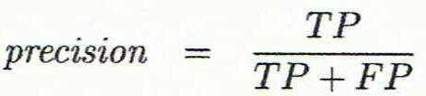
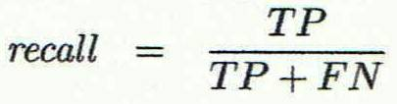
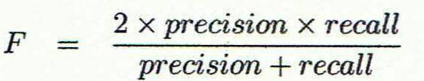
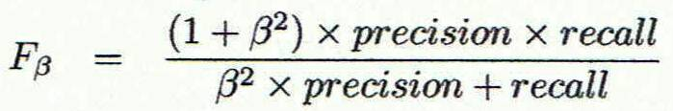
Classifier Evaluation Metrics: Precision and Recall, and F-measures
Precision: exactness – what % of tuples that the classifier labeled as positive are actually positive
Recall: completeness – what % of positive tuples did the classifier label as positive?
Perfect score is 1.0
Inverse relationship between precision & recall
F measure (F₁ or F-score): harmonic mean of precision and recall,
F_{ß}: weighted measure of precision and recall
assigns ß times as much weight to recall as to precision
54

Slide 55
Classifier Evaluation Metrics: Example
Actual Class\Predicted class | cancer = yes | cancer = no | Total | Recognition(%)
cancer = yes | 90 | 210 | 300 | 30.00 (sensitivity
cancer = no | 140 | 9560 | 9700 | 98.56 (specificity)
Total | 230 | 9770 | 10000 | 96.40 (accuracy)
Precision = 90/230 = 39.13% Recall = 90/300 = 30.00%
55

Slide 56
Evaluating Classifier Accuracy: Holdout & Cross-Validation Methods
Holdout method
Given data is randomly partitioned into two independent sets
Training set (e.g., 2/3) for model construction
Test set (e.g., 1/3) for accuracy estimation
Random sampling: a variation of holdout
Repeat holdout k times, accuracy = avg. of the accuracies obtained
Cross-validation (k-fold, where k = 10 is most popular)
Randomly partition the data into k mutually exclusive subsets, each approximately equal size
At i-th iteration, use D_{i} as test set and others as training set
Leave-one-out: k folds where k = # of tuples, for small sized data
*Stratified cross-validation*: folds are stratified so that class dist. in each fold is approx. the same as that in the initial data
56

Slide 57

Evaluating Classifier Accuracy: Bootstrap
Bootstrap
Works well with small data sets
Samples the given training tuples uniformly with replacement
i.e., each time a tuple is selected, it is equally likely to be selected again and re-added to the training set
Several bootstrap methods, and a common one is .632 boostrap
A data set with d tuples is sampled d times, with replacement, resulting in a training set of d samples. The data tuples that did not make it into the training set end up forming the test set. About 63.2% of the original data end up in the bootstrap, and the remaining 36.8% form the test set (since (1 – 1/d)^{d} ≈ e⁻¹ = 0.368)
Repeat the sampling procedure k times, overall accuracy of the model:
57

Slide 58


Estimating Confidence Intervals: Classifier Models M₁ vs. M₂
Suppose we have 2 classifiers, M₁ and M₂, which one is better?
Use 10-fold cross-validation to obtain and
These mean error rates are just estimates of error on the true population of future data cases
What if the difference between the 2 error rates is just attributed to chance?
Use a test of statistical significance
Obtain confidence limits for our error estimates
58

Slide 59
Model Selection: ROC Curves
ROC (Receiver Operating Characteristics) curves: for visual comparison of classification models
Originated from signal detection theory
Shows the trade-off between the true positive rate and the false positive rate
The area under the ROC curve is a measure of the accuracy of the model
Rank the test tuples in decreasing order: the one that is most likely to belong to the positive class appears at the top of the list
The closer to the diagonal line (i.e., the closer the area is to 0.5), the less accurate is the model
Vertical axis represents the true positive rate
Horizontal axis rep. the false positive rate
The plot also shows a diagonal line
A model with perfect accuracy will have an area of 1.0
59

Slide 60
Issues Affecting Model Selection
Accuracy
classifier accuracy: predicting class label
Speed
time to construct the model (training time)
time to use the model (classification/prediction time)
Robustness: handling noise and missing values
Scalability: efficiency in disk-resident databases
Interpretability
understanding and insight provided by the model
Other measures, e.g., goodness of rules, such as decision tree size or compactness of classification rules
60
Notes:
60

Slide 61
Classification of Class-Imbalanced Data Sets
Class-imbalance problem: Rare positive example but numerous negative ones, e.g., medical diagnosis, fraud, oil-spill, fault, etc.
Traditional methods assume a balanced distribution of classes and equal error costs: not suitable for class-imbalanced data
Typical methods for imbalance data in 2-class classification:
Oversampling: re-sampling of data from positive class
Under-sampling: randomly eliminate tuples from negative class
Threshold-moving: moves the decision threshold, t, so that the rare class tuples are easier to classify, and hence, less chance of costly false negative errors
Ensemble techniques: Ensemble multiple classifiers introduced above
Still difficult for class imbalance problem on multiclass tasks
61

Slide 62
Predictor Error Measures
Measure predictor accuracy: measure how far off the predicted value is from the actual known value
Loss function: measures the error betw. y_{i} and the predicted value y_{i}’
Absolute error: | y_{i} – y_{i}’|
Squared error: (y_{i} – y_{i}’)²
Test error (generalization error): the average loss over the test set
Mean absolute error: Mean squared error:
Relative absolute error: Relative squared error:
The mean squared-error exaggerates the presence of outliers
Popularly use (square) root mean-square error, similarly, root relative squared error
62
Notes:
62

